Slide 1
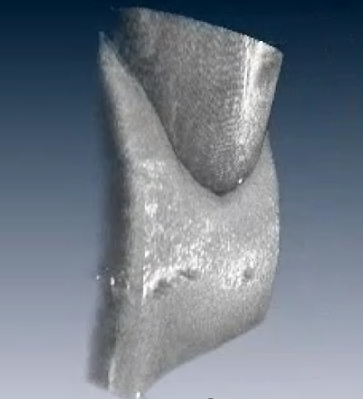
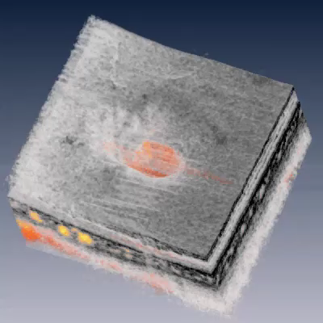

Slide 2
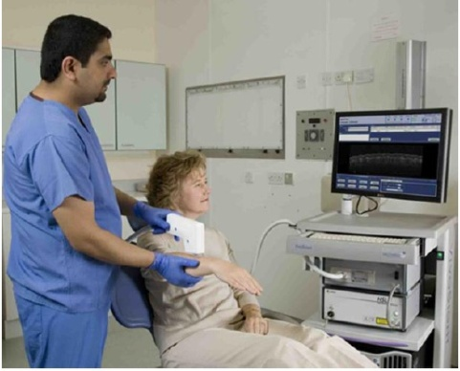
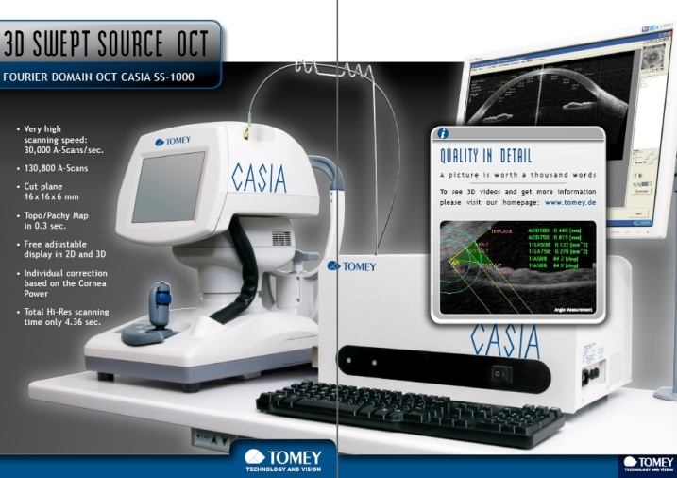
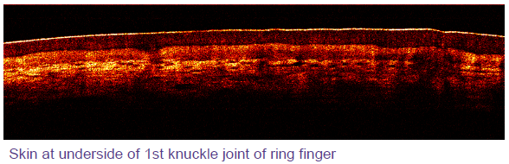
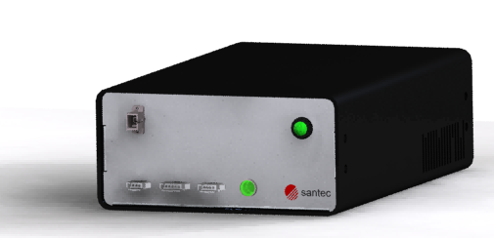
EX 1. Ophthalmology
World-first anterior segment diagnostics system based on Santec HSL-200 (TOMEY corporation, Japan)
EX 2. Endoscopy/General clinical use
First clinical use in EU area based on Santec HSL-2000 (Michelson Diagnostics Ltd.)
OEM engine, HSL-200

Slide 3

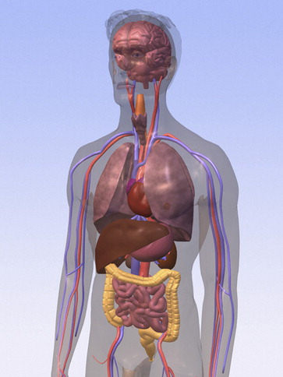
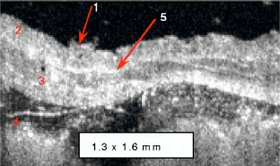
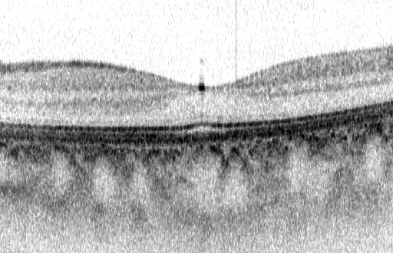
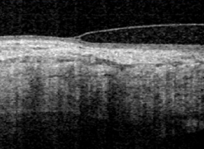
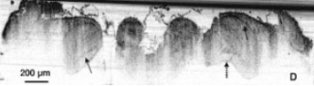
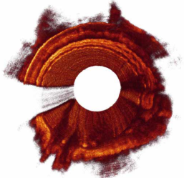
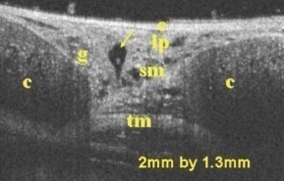
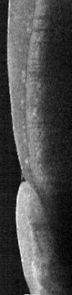
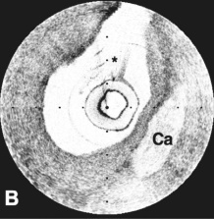
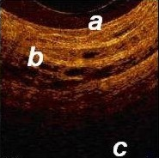
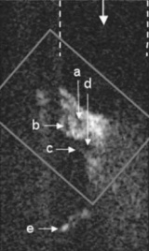
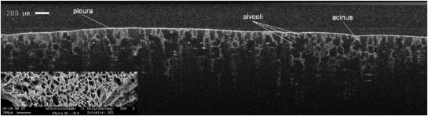
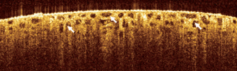
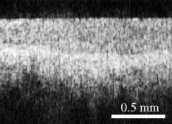
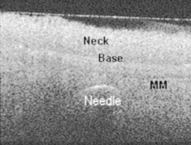
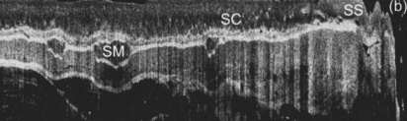
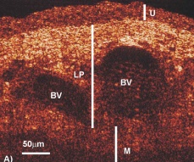
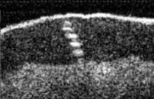
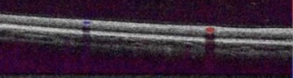
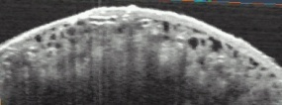
Medical applications
Oral
Eye
Brain
Esophagus
Trachea
Kostadinka Bizheva, et al.,
J. of Biomedical Optics,
July/ 2004 Vol.9 No.4
Courtesy of Tsukuba Univ.
Matthew Brenner, et al.,
J. of Biomedical Optics,
Sep/ 2007 Vol.12 No.5
Petra Wilder-Smith, et al.
J. of Biomedical Optics Sep/ 2005 Vol.10 No.5
Tooth
Cardiovascular
Z.P.Chen, et al.,
Opt. Express, Aug/ 2007
Vol. 15 No. 16
Pancrea
Cochlea
Lung
Guillermo J. Tearney, et al.
J. of Biomedical Optics
Mar/ 2006 Vol.11 No.2
Alexander Popp, et al.,
J. of Biomedical Optics, Jan/ 2004
Vol.11 No.1
Pier Alberto, et al.
J Pancreas (Online)
2007 Vol.8 No.2
Fangyi Chen, et al.,
J. of Biomedical Optics,
Mar/ 2007 Vol.12 No.2
Kidney
Cervix
Stomach
Colon
Yu Chen, et al.
J. of Biomedical Optics
Sep/ 2007 Vol.12 No.3
Bladder
Ilya V. Turchin, et al.,
J. of Biomedical Optics,
Nov/ 2005 Vol.10 No.6
Alexandre R. Tumlinson, et al.,
J. of Biomedical Optics,
Nov/ 2006 Vol.11 No.6
Yonghong He, et al.
J. of Biomedical Optics
Jan/ 2004 Vol.9 No.1
Skin
Blood flow
Bone
Ying T. Pan, et al.
J. of Biomedical Optics
Sep/ 2007 Vol.12 No.5
Bradley A. Bower., J. of Biomedical Optics,
Jul/ 2007 Vol.12 No.4
Notes:
3

Slide 4
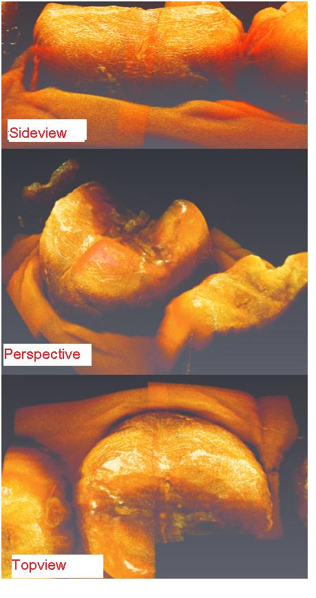
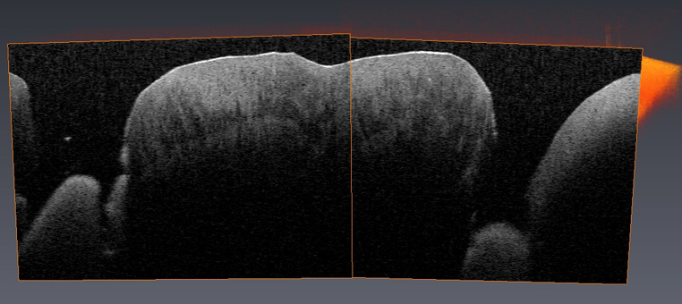
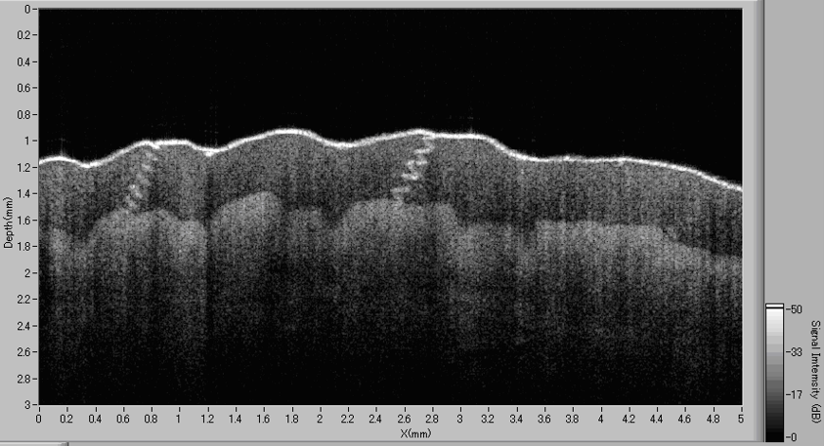
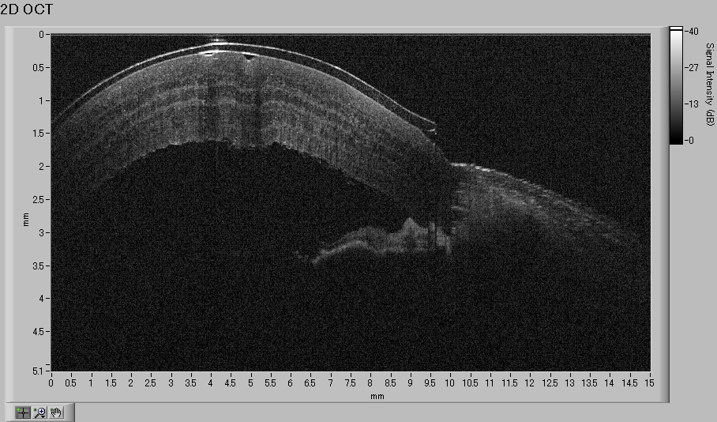
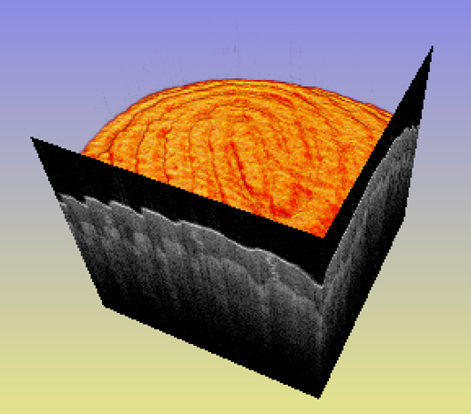
Teeth
Gland under finger skin
Contact lens on porcine cornea
Fingertip

Slide 5
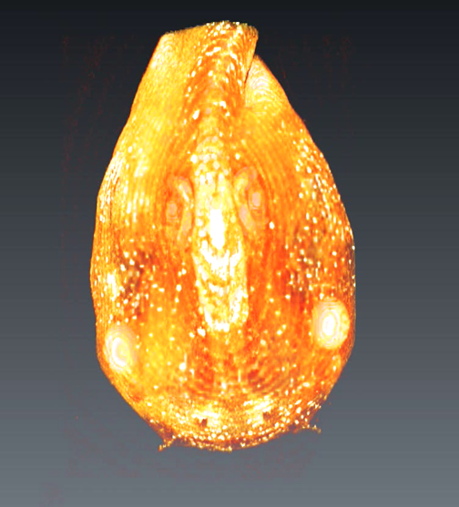
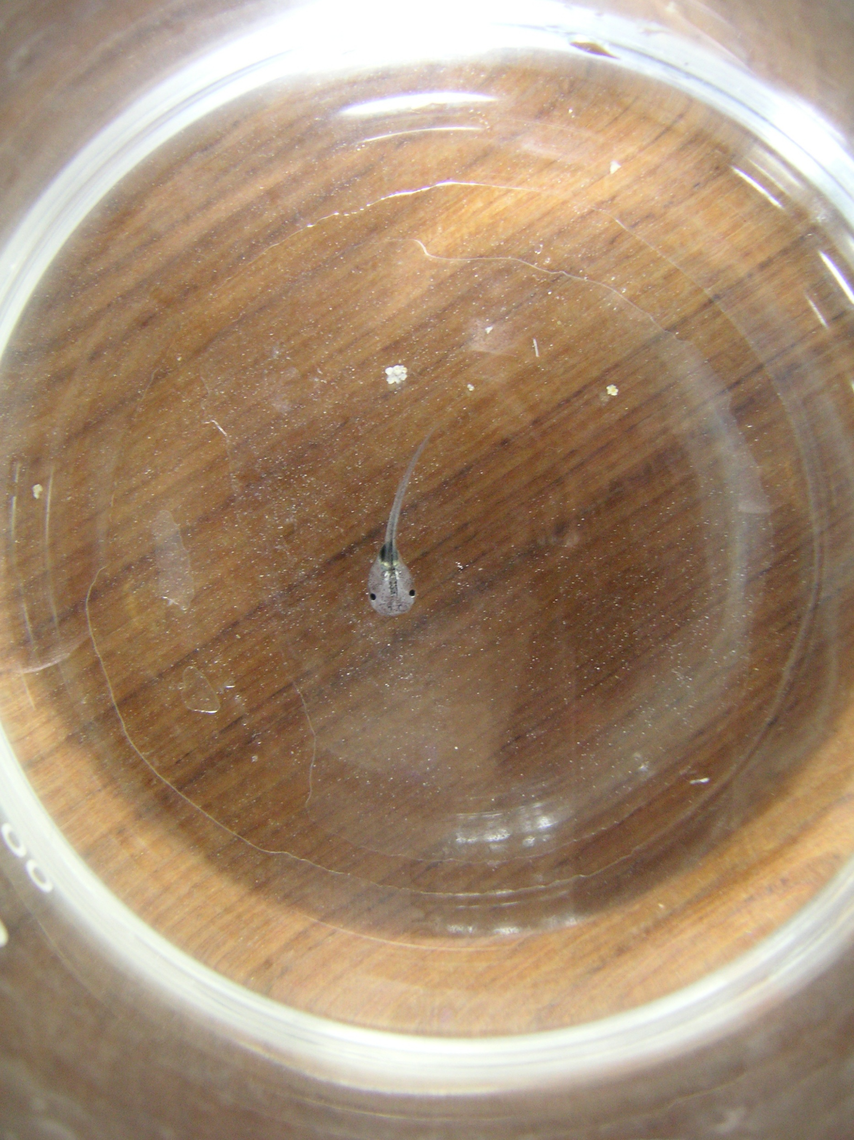
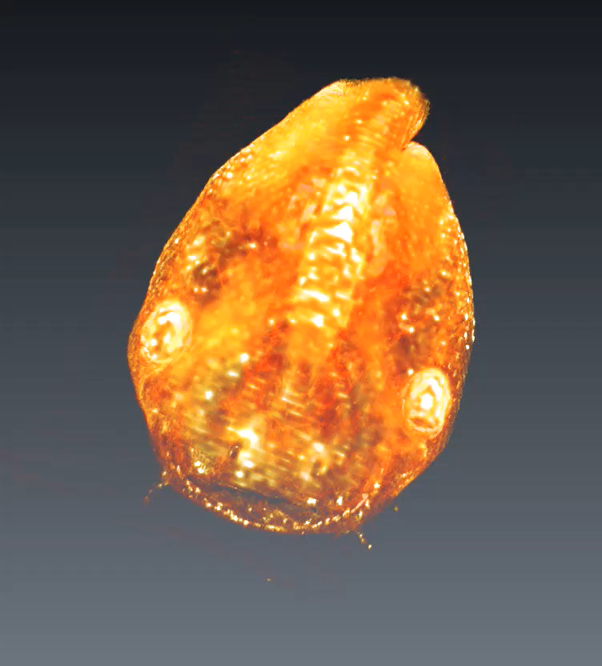
OCT：光を使って非破壊で断層構造をみる技術
光干渉断層法 [Optical Coherence Tomography]
おたまじゃくし写真
X線、超音波と比べると ①精細な画像 ②被爆しない ③低価格

